Slide 1
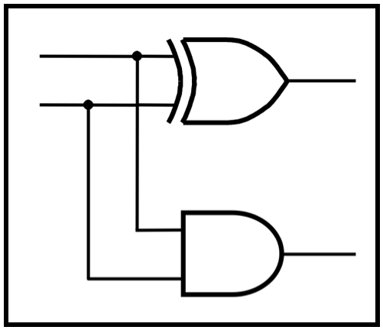
CprE 281:
Digital Logic
Instructor: Alexander Stoytchev
http://www.ece.iastate.edu/~alexs/classes/

Slide 2
T Flip-Flops
&
JK Flip-Flops
CprE 281: Digital Logic
Iowa State University, Ames, IA
Copyright © Alexander Stoytchev

Slide 3
Administrative Stuff
Homework 8 is due next Monday.
The second midterm exam is next Friday.

Slide 4
Administrative Stuff
Midterm Exam #2
When: Friday October 28 @ 4pm.
Where: This classroom
What: Chapters 1, 2, 3, 4 and 5.1-5.8
The exam will be open book and open notes (you can bring up to 3 pages of handwritten notes).

Slide 5
Midterm 2: Format
The exam will be out of 130 points
You need 95 points to get an A
It will be great if you can score more than 100 points.
  but you can’t roll over your extra points ☹

Slide 6
Midterm 2: Topics
Binary Numbers and Hexadecimal Numbers
1’s complement and 2’s complement representation
Addition and subtraction of binary numbers
Circuits for adders and fast adders
Single and Double precision IEEE floating point formats
Converting a real number to the IEEE format
Converting a floating point number to base 10
Multiplexers (circuits and function)
Synthesis of logic functions using multiplexers
Shannon’s Expansion Theorem

Slide 7
Midterm 2: Topics
Decoders (circuits and function)
Demultiplexers
Encoders (binary and priority)
Code Converters
K-maps for 2, 3, and 4 variables
Synthesis of logic circuits using adders, multiplexers, encoders, decoders, and basic logic gates
Synthesis of logic circuits given constraints on the available building blocks that you can use
Latches (circuits, behavior, timing diagrams)
Flip-Flops (circuits, behavior, timing diagrams)
Registers and Register Files

Slide 8
T Flip-Flop

Slide 9
Motivation
A slight modification of the D flip-flop that can be used for some nice applications.
In this case, T stands for Toggle.

Slide 10
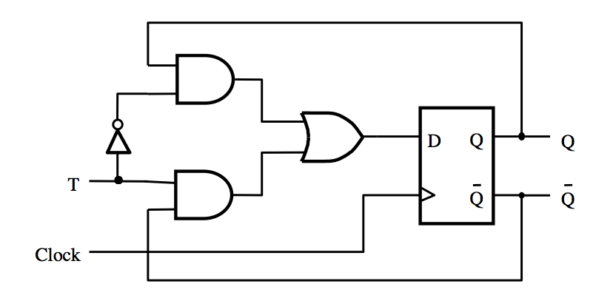
T Flip-Flop
[ Figure 5.15a from the textbook ]

Slide 11
T Flip-Flop
Positive-edge-triggered
D Flip-Flop
[ Figure 5.15a from the textbook ]

Slide 12
T Flip-Flop
What is this?
[ Figure 5.15a from the textbook ]

Slide 13
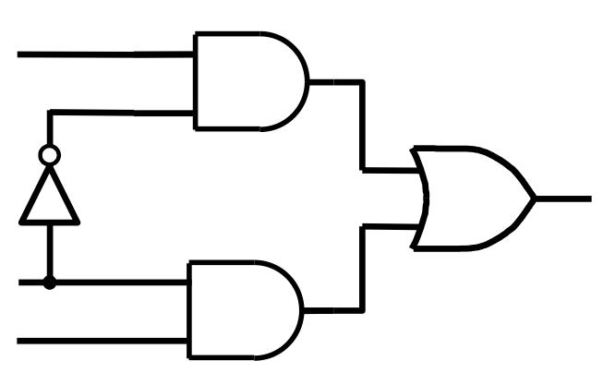
What is this?
Q
D
T
Q

Slide 14
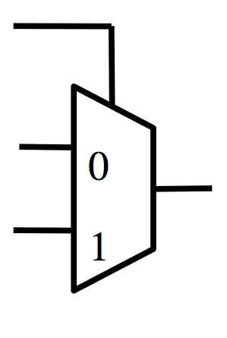
It is a 2-to-1 Multiplexer
Q
D
T
T
Q
Q
D
Q

Slide 15
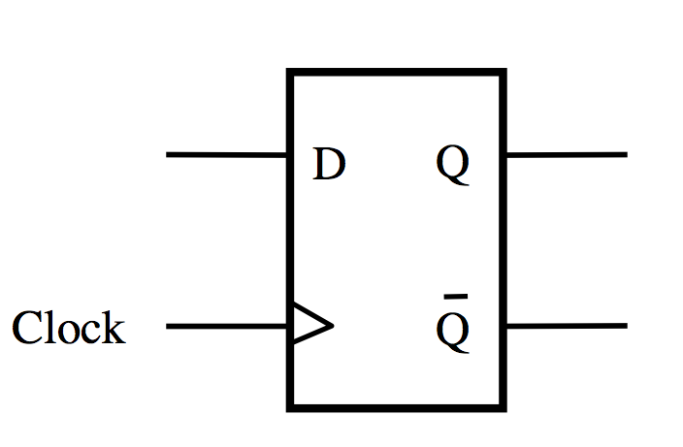
What is this?
T
+
= ?
Q
D
Q

Slide 16
It is a T Flip-Flop
T
0
D
Q
1
Clock
Q

Slide 17
It is a T Flip-Flop
T
Q
0
D
Q
Q
1
Clock
Q
Note that the two inputs to the multiplexer are inverses of each other.

Slide 18
Another Way to Draw This
T
Q
0
D
Q
Q
1
Clock
Q

Slide 19
Another Way to Draw This
T
Q
0
D
Q
Q
1
Clock
Q
What is this?

Slide 20

What is this?
Q
D
T

Slide 21
What is this?
Q
D
T
D = QT + QT

Slide 22
It is an XOR
Q
D
T
D = Q + T

Slide 23
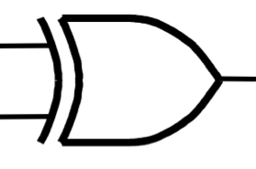
It is an XOR
Q
D
T
D = Q + T

Slide 24
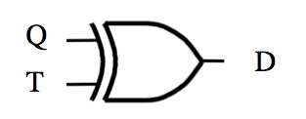
What is this?
+
= ?

Slide 25
It is a T Flip-Flop too
T
D
Q
Clock
Q

Slide 26
It is a T Flip-Flop too
T
D
Q
Clock
Q
T | Q | D
0 | 0 | 0
0 | 1 | 1
1 | 0 | 1
1 | 1 | 0

Slide 27
It is a T Flip-Flop too
T
D
Q
Clock
Q
T | Q | D
0 | 0 | 0
0 | 1 | 1
1 | 0 | 1
1 | 1 | 0
Q
Q

Slide 28
T Flip-Flop
(how it works)
If T=0 then it stays in its current state
If T=1 then it reverses its current state
In other words the circuit “toggles” its state
when T=1. This is why it is called T flip-flop.

Slide 29
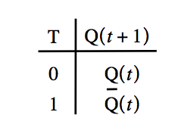
T Flip-Flop
(circuit and truth table)
[ Figure 5.15a,b from the textbook ]

Slide 30
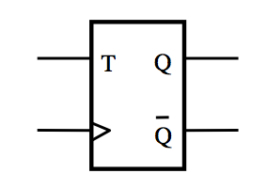
T Flip-Flop
(circuit and graphical symbol)
[ Figure 5.15a,c from the textbook ]

Slide 31
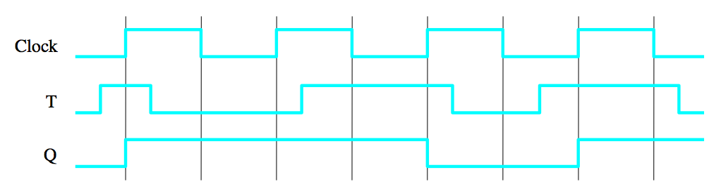
T Flip-Flop (Timing Diagram)
1
1
1
0
1
1
1
1
1
0
0
[ Figure 5.15d from the textbook ]

Slide 32
T Flip-Flop (Timing Diagram)
Decision Point
1
1
1
0
1
1
1
1
1
0
0
0
[ Figure 5.15d from the textbook ]

Slide 33
T Flip-Flop (Timing Diagram)
1
1
1
0
1
1
1
1
1
0
0
0
[ Figure 5.15d from the textbook ]

Slide 34
T Flip-Flop (Timing Diagram)
1
1
1
0
1
1
1
1
1
0
0
0
[ Figure 5.15d from the textbook ]

Slide 35
T Flip-Flop (Timing Diagram)
1
1
1
0
1
1
1
1
1
0
0
0
[ Figure 5.15d from the textbook ]

Slide 36
JK Flip-Flop

Slide 37
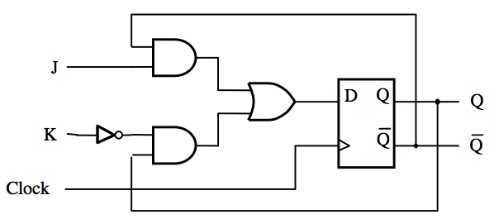
JK Flip-Flop
D = JQ + KQ
[ Figure 5.16a from the textbook ]

Slide 38
JK Flip-Flop
J
D
Q
Q
K
Q
Q
Clock
(a) Circuit
J
K
Q
(
t
+
1
)
0
0
Q
(
t
)
Hold
Reset
Set
Toggle
J
Q
0
1
0
1
0
1
K
Q
1
1
Q
(
t
)
(b) Truth table
(c) Graphical symbol
[ Figure 5.16 from the textbook ]

Slide 39
JK Flip-Flop
(how it works)
A versatile circuit that can be used both as a SR flip-flop and as a T flip flop
If J=0 and S =0 it stays in the same state
Just like SR It can be set and reset
J=S and K=R
If J=K=1 then it behaves as a T flip-flop

Slide 40
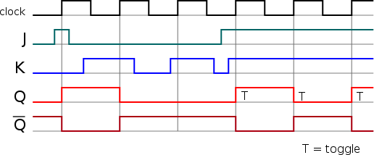
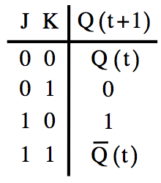
JK Flip-Flop
(timing diagram)

Slide 41
JK Flip-Flop
(timing diagram)

Slide 42
JK Flip-Flop
(timing diagram)

Slide 43
JK Flip-Flop
(timing diagram)

Slide 44
Questions?

Slide 45
THE END

